Slide 1
Circumference of a circle
Perimeter, area and volume

Slide 2
how to use Oak lessons

Slide 3
I can use the relationship C = πd to calculate unknown lengths in contexts involving the circumference of circles.

Slide 4
The circumference of a circle is the perimeter of the circle.
The radius is any line segment that joins the centre of a circle to its edge.
The diameter of a circle is any line segment that starts and ends on the edge of the circle and passes through the centre.

Slide 5

Circumference of a circle
Using a formula to calculate the circumference
Using a formula to calculate the diameter and radius

Slide 6
Using a formula to calculate the circumference
The circumference of a circle can be calculated when the diameter is known by using the formula C = πd.
C
C = πd
d
circumference = π × diameter

Slide 7
Using a formula to calculate the circumference
The circumference of a circle can be calculated when the radius is known by using the formula C = 2πr.
C
C = 2πr
r
circumference = 2 × π × radius

Slide 8
Using a formula to calculate the circumference
These formulae give the same result because the diameter is double the length of the radius.
C
C
d
r
r
C = πd
C = 2πr

Slide 9
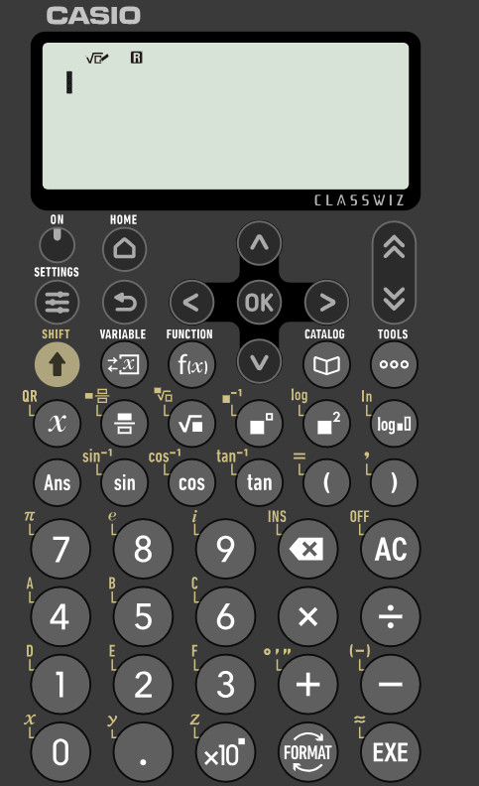


Using a formula to calculate the circumference
Calculations involving circles can be performed accurately by using the π button on a scientific calculator.
On this calculator the π symbol is above the 7 button.
shift button
So, you need press the shift button before pressing the 7 button to enter π.
π button

Slide 10
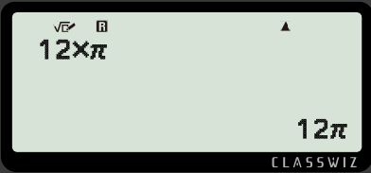
Using a formula to calculate the circumference
We can use the diameter and the formula C = πd to calculate the circumference of the circle.
C
C = πd
12 cm
C = π × 12
C = 12π cm
Using this calculator, we would use the buttons:

Slide 11
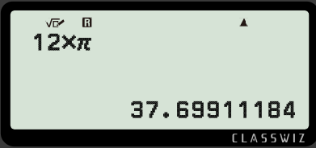
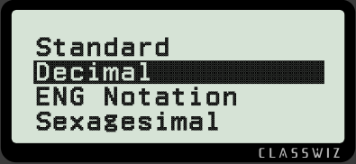
Using a formula to calculate the circumference
We can use the diameter and the formula C = πd to calculate the circumference of the circle.
C
C = πd
12 cm
C = π × 12
C = 37.7 cm
We can convert the answer to a decimal by pressing format and then selecting decimal.
We can convert the answer to a decimal by pressing format and then selecting decimal. We would then need to round our answer.

Slide 12
Using a formula to calculate the circumference
We can use the diameter and the formula C = πd to calculate the circumference of the circle.
C
C = πd
12 cm
C = π × 12
C = 12π cm
C = 37.7 cm
C = 37.699112 cm
C = 37.69911184 cm
C = 37.699 cm
The more decimal places we use, the more accurate our answer will be.
The only way to be exact is to give our answer in terms of π.

Slide 13
Using a formula to calculate the circumference
We can use the radius and the formula C = 2πr to calculate the circumference of the circle.
C
Using the radius:
Using the diameter:
6 cm
C = 2πr
C = πd
C = 2 × π × 6
C = π × 12
C = 12π cm
C = 12π cm
This gives the same result as using the diameter because the diameter is double the length of the radius.

Slide 14

Using a formula to calculate the circumference
We can only calculate the circumference when we know the diameter.
We can use the radius to calculate the circumference by using the formula C = 2πr.
We need to know the diameter so that we can use the formula C = πd.

Slide 15
Using a formula to calculate the circumference
When multiplying a number by π, the only way to provide an exact answer is to write it in terms of π.
We can be exact by writing down all of the decimals on our calculator display.
π has an infinite number of decimal places, so writing in terms of π is the only way to be exact.

Slide 16
Using a formula to calculate the circumference
Find the circumference of the circle. Give your answer to 1 decimal place.
Find the circumference of the circle. Give your answer to 1 decimal place.
diameter = 26 mm
diameter = 4 m
C = πd
C = πd
C = π × 26
C = π × 4
C = 81.6814…
C = 12.56637…
26 mm
4 m
C = 81.7 mm
C = 12.6 m
(to 1 d.p.)
(to 1 d.p.)

Slide 17
Using a formula to calculate the circumference
Find the circumference of the circle. Give your answer in terms of π.
Find the circumference of the circle. Give your answer in terms of π.
8 cm
radius = 8 cm
5 m
radius = 5 m
C = 2πr
C = 2πr
C = 2 × π × 8
C = 2 × π × 5
C = 16π cm
C = 10π m

Slide 18
Using a formula to calculate the circumference
1) Calculate the circumference of each circle. Give each answer: i) in terms of π; ii) rounded to 3 significant figures.
a)
b)
i) π cm
i)
9 cm
ii) cm
ii)
5 cm
c)
d)
12 cm
i)
i)
5.5 cm
ii)
ii)

Slide 19
Using a formula to calculate the circumference
2) Calculate the circumference of each circle. Give each answer rounded to 1 decimal place.
a)
b)
c)
d)
14 m
17 m
4.1 m
8.2 m
22.8 m
11.4 m
1 m

Slide 20
Using a formula to calculate the circumference
1) Calculate the circumference of each circle. Give each answer: i) in terms of π; ii) rounded to 3 significant figures.
a)
b)
i) 9π cm
i) 10π cm
9 cm
ii) 28.3 cm
ii) 31.4 cm
5 cm
c)
d)
12 cm
i) 11π cm
i) 12π cm
5.5 cm
ii) 34.6 cm
ii) 37.7 cm

Slide 21
Using a formula to calculate the circumference
2) Calculate the circumference of each circle. Give each answer rounded to 1 decimal place.
a)
b)
c)
d)
14 m
17 m
4.1 m
8.2 m
22.8 m
11.4 m
1 m
71.6 m
71.6 m
25.8 m
12.6 m

Slide 22
Circumference of a circle
Using a formula to calculate the circumference
Using a formula to calculate the diameter and radius

Slide 23
Using a formula to calculate the diameter and radius
In cases where the circumference is known, the formulae C = πd and C = 2πr can be used to calculate the diameter or radius.
This can be done by substituting the known values into a formula to form an equation and then rearranging the equation.
This will usually involve dividing the circumference by π or 2π.
Decimal answers may need to be rounded to a suitable degree of accuracy.

Slide 24



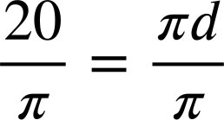
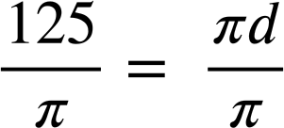




Using a formula to calculate the diameter and radius
The circumference of the circle is 20 cm. Calculate the diameter.
The circumference of the circle is 125 mm. Calculate the diameter.
20 cm
d
d
125 mm
(to 3 s.f.)
(to 3 s.f.)

Slide 25



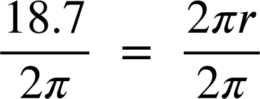
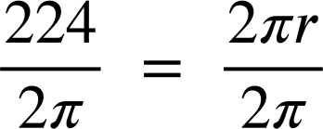




Using a formula to calculate the diameter and radius
The circumference of the circle is 18.7 cm. Calculate the radius.
The circumference of the circle is 224 cm. Calculate the radius.
r
r
(to 3 s.f.)
(to 3 s.f.)

Slide 26


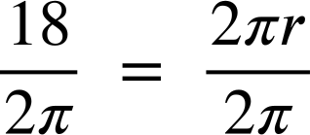
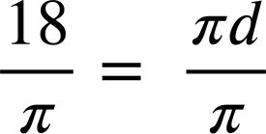





Using a formula to calculate the diameter and radius
An alternative method for calculating the radius could be to first calculate the diameter and then divide by 2.
Example: calculate the radius, giving your answer to 2 d.p.
18 m
Method 1:
Method 2:
Why are the solutions slightly different?

Slide 27
Using a formula to calculate the diameter and radius
Rounding reduces the accuracy of an answer. Calculating with rounded numbers is less accurate than calculating with the unrounded number.
The accuracy of this method could be improved by halving the diameter before rounding.
Method 2:
This problem could be avoided by using C = 2πr to calculate radius and C = πd to calculate diameter.
5.73 m = d
2.86 m = r
2.87 m = r

Slide 28


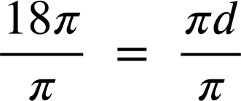

Using a formula to calculate the diameter and radius
When the circumference of a circle is a multiple of π, each side of the equation will have π as a factor.
Dividing π by π gives 1, so π will cancel on both sides of the equation.
Example: the circumference of a circle is 18π m. Find the diameter.
18π m
circumference = 18π m
diameter = 18 m
d

Slide 29
Using a formula to calculate the diameter and radius
Which is the least accurate method for calculating the diameter of a circle?
Use the formula C = πd to calculate the diameter.
Use the formula C = 2πr to calculate the radius, round the answer and then multiply by 2 to get the diameter.
Use the formula C = 2πr to calculate the radius, multiply by 2 to get the diameter and then round the answer.

Slide 30
Using a formula to calculate the diameter and radius
The circumference of the circle is 14π m. Calculate the diameter.
14π m
diameter = 14 m
d

Slide 31
Using a formula to calculate the diameter and radius
1) Calculate the length labelled in each diagram. Round decimals to 1 decimal place.
a)
C = 15 m
b)
C = 15π m
c)
C = 21.2 cm
u
w
v
d)
C = 9 mm
e)
C₁ = 14 cm
z = total height
C₂ = 36 cm
z
y
x

Slide 32
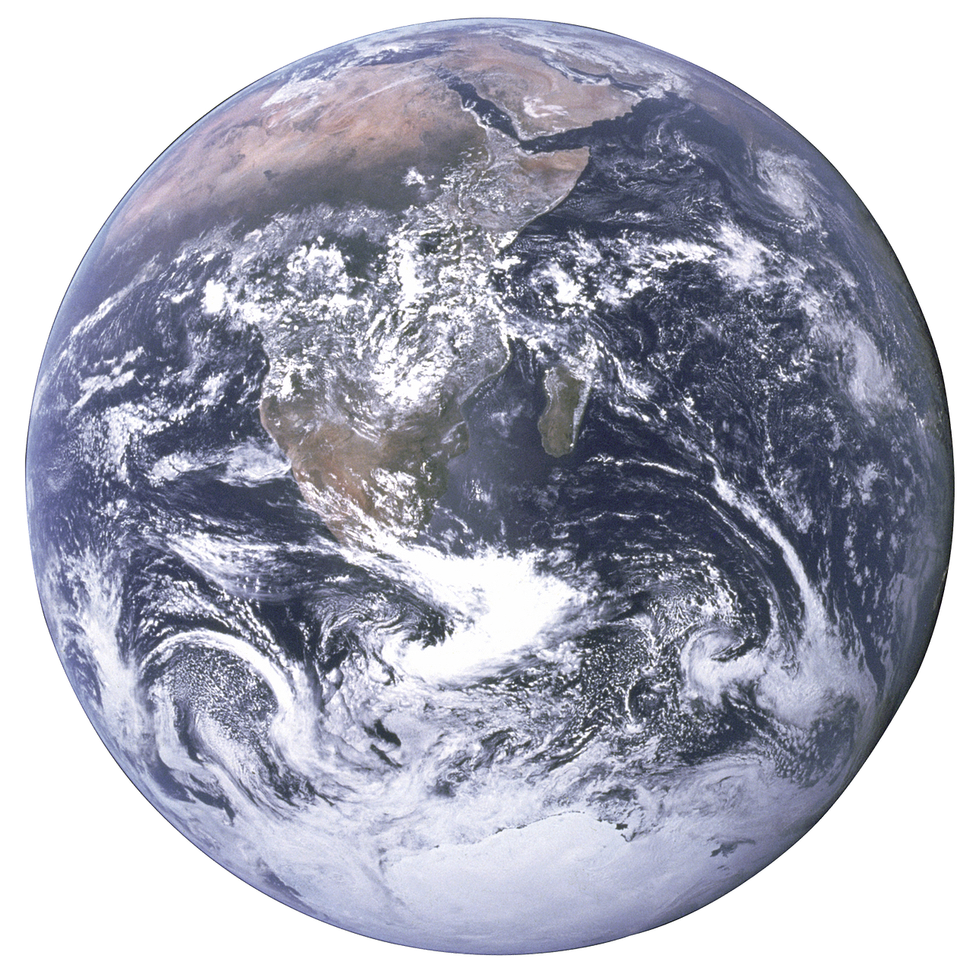
Using a formula to calculate the diameter and radius
2) The diagram is a 2D representation of the International Space Station orbiting
the Earth. The diagram is not drawn to scale.
International Space Station
a) The circumference of Earth is approximately 40 075 km.
Calculate the radius of Earth (to the nearest km).
b) The circumference of the space station’s orbit is approximately 42 590 km.
Calculate the distance between the space station and the centre of the Earth (to the nearest km).
c) How far is the space station above the ground (to the nearest km)?

Slide 33
Using a formula to calculate the diameter and radius
1) Calculate the length labelled in each diagram. Round decimals to 1 decimal place.
a)
C = 15 m
b)
C = 15π m
c)
C = 21.2 cm
u
w
u = 4.8 m
v = 15 m
w = 3.4 cm
v
d)
C = 9 mm
e)
C₁ = 14 cm
z = total height
C₂ = 36 cm
z
y
x = 1.4 mm
x
y = 2.9 mm
z = 15.9 cm

Slide 34
Using a formula to calculate the diameter and radius
2) The diagram is a 2D representation of the International Space Station orbiting
the Earth. The diagram is not drawn to scale.
International Space Station
a) The circumference of Earth is approximately 40 075 km.
Calculate the radius of Earth (to the nearest km).
b) The circumference of the space station’s orbit is approximately 42 590 km.
Calculate the distance between the space station and the centre of the Earth (to the nearest km).
c) How far is the space station above the ground (to the nearest km)?
6378 km
6778 km
400 km

Slide 35
Circumference of a circle
The formula C=πd can be used to find the circumference when you know the diameter.
The formula C=2πr can be used to find the circumference when you know the radius.
The formulae can be used to find the radius or diameter when you know the circumference.
Answers written as a decimal will need to be rounded to an appropriate degree of accuracy.
An answer can be exact by writing it in terms of π.

Slide 36

© Oak National Academy 2023.
Produced in partnership with Mathematics in Education and Industry.
Licensed on the Open Government Licence v3.0, except where otherwise stated. See Oak terms and conditions.

